Slide 1
Techniques of Molecular Biology
BT 451
Chapter 7

Slide 2
Techniques
Nucleic Acids
Proteins

Slide 3
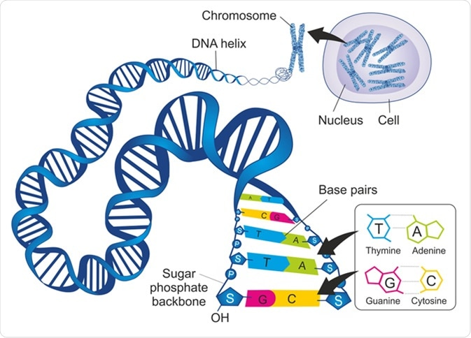
Nucleic Acids

Slide 4
DNA Hybridization Can Be Used to Identify Specific DNA Molecules
Hybridization
the process of base-pairing between complementary single-stranded polynucleotides from two different sources under the appropriate conditions of ionic strength and temperature.

Slide 5
Hybridization Probes Can Identify Electrophoretically-separated DNAs and RNAs
Probe with defined sequence – either a purified fragment or a chemically synthesized DNA molecule is used to search mixtures of nucleic acids for molecules containing a complementary sequence.
Probe must be labeled in the first place.

Slide 6
Methods for labeling DNA
Synthesizing new DNA in the presence of a labeled precursor modified with either a fluorescent moiety or radioactive atoms by using PCR or hybridizing short random hexameric oligonucleotides to DNA and allowing a DNA polymerase to extend them.
Adding a label to the end of an intact DNA molecule

Slide 7
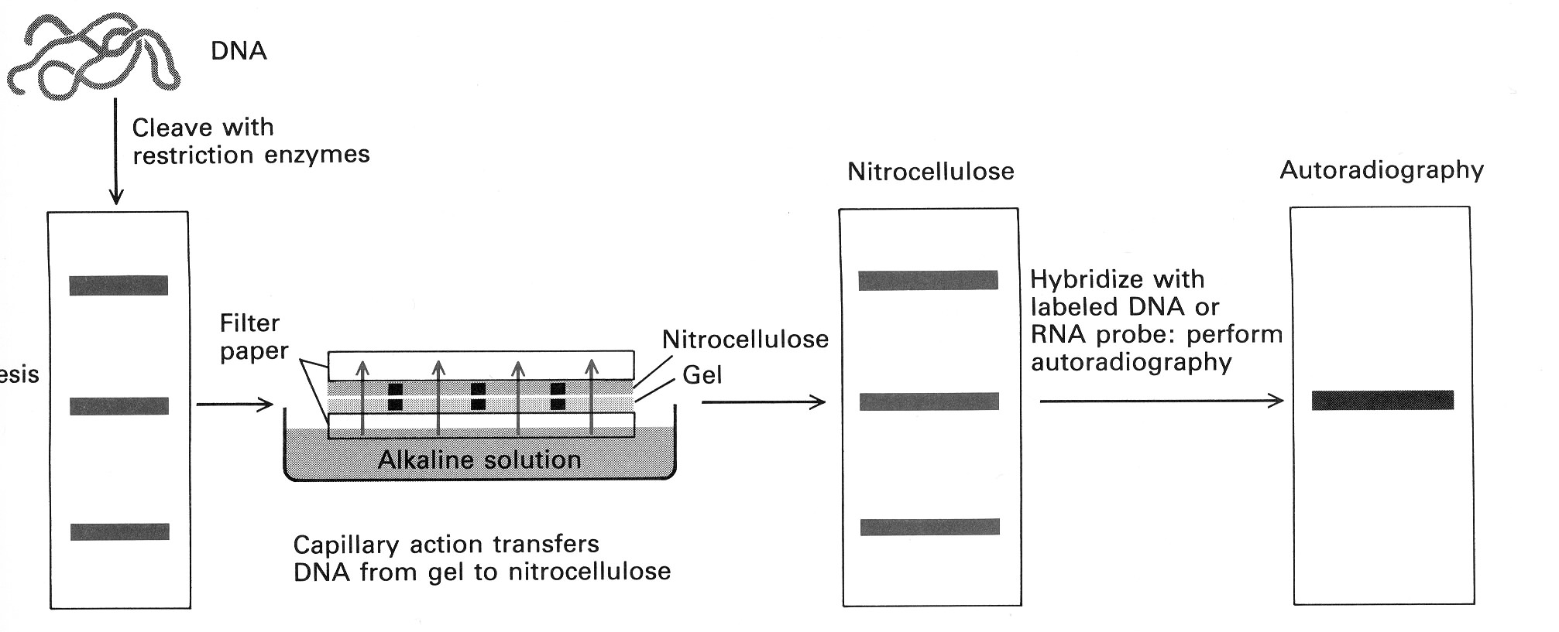
Southern blot hybridization
ETOH ppt
Spin
Phenol
Chloro
ProtK
SDS
tissue
Paper Towels

Slide 8
Northern blot hybridization
Hybridizing between complementary strands of DNA and RNA
Identify a particular mRNA in a population of RNAs
The protocol is basically the same as southern blotting
Difference is that relatively short RNAs need not be digested with any enzymes

Slide 9
Libraries of DNA Molecules
DNA library
a population of identical vectors that each contains a different DNA insert

Slide 10
Using Restriction Enzymes to Make a Recombinant DNA Plasmid
Bacterial restriction enzymes cut DNA molecules at specific DNA sequences called restriction sites
A restriction enzyme usually makes many cuts, yielding restriction fragments
The most useful restriction enzymes cut DNA in a staggered way, producing fragments with at least one single-stranded end called a sticky end

Slide 11
Sticky ends can bond with complementary sticky ends of other fragments
DNA ligase is an enzyme that seals the bonds between restriction fragments
This allows researchers to join two DNA fragments from different sources

Slide 12
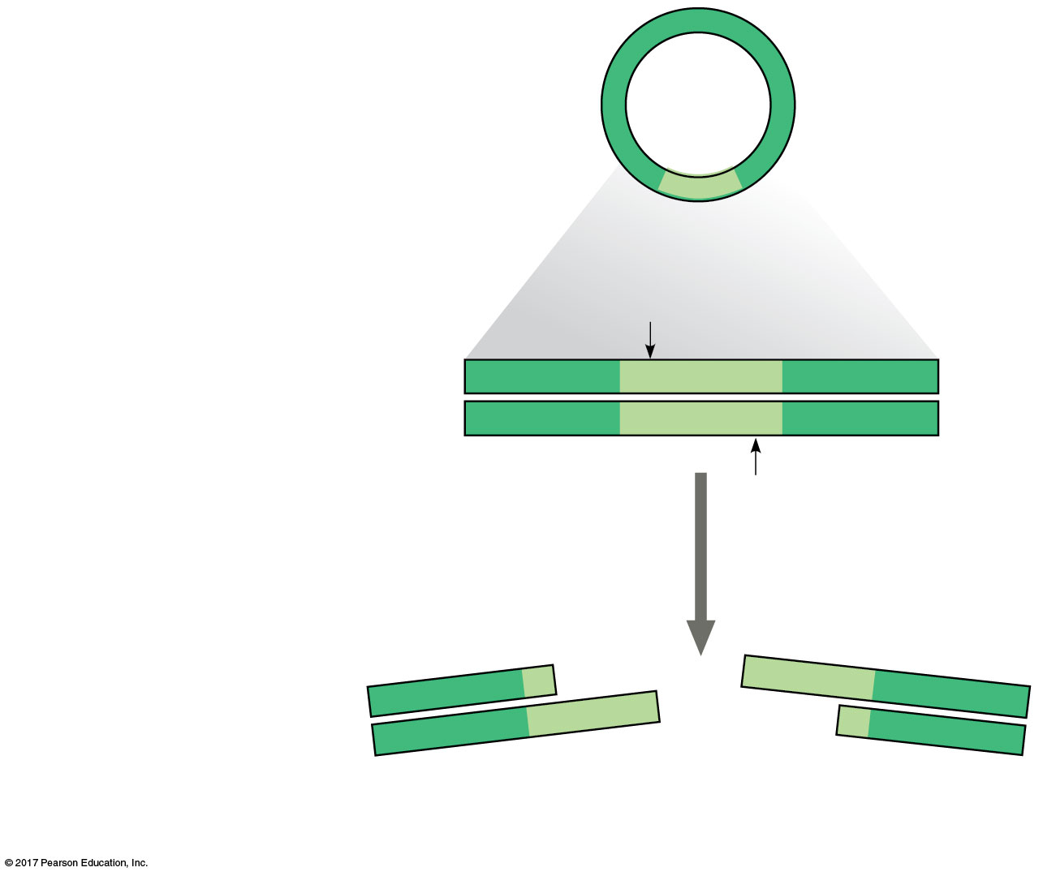
Bacterial
plasmid
Restriction site
5′
3′
DNA
GAATTC
CTTAAG
3′
5′
1
Restriction enzyme cuts
the sugar-phosphate
backbones at each arrow.
3′
5′
5′
3′
G
AATTC
CTTAA
G
5′
3′
3′
Sticky
end
5′
© 2018 Pearson Education Ltd.

Slide 13
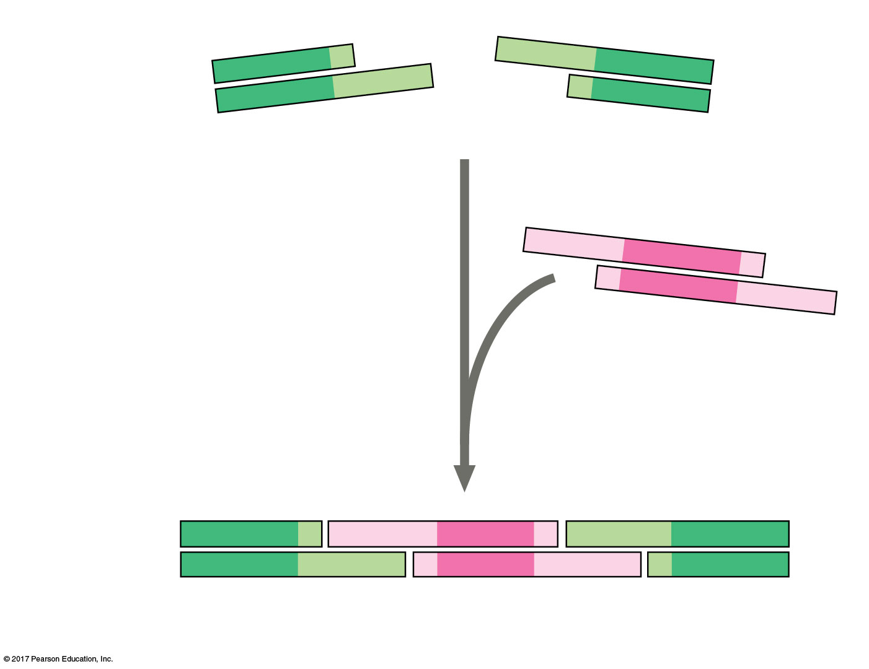
3′
5′
5′
A
3′
G
A
T
T
C
C
T
T
A
A
G
5′
3′
3′
Sticky
end
5′
5′
2
Base pairing of sticky
ends produces various
combinations.
A
A
3′
T
T
C
G
G
3′
C
T
T
A
A
5′
Fragment from different
DNA molecule cut by the
same restriction enzyme
5′
3′5′
3′5′
3′
G
AAT T C
G
AAT T C
C
T TA A
G
C
T TA A
G
3′
5′3′
5′3′
5′
One possible combination
© 2018 Pearson Education Ltd.

Slide 14
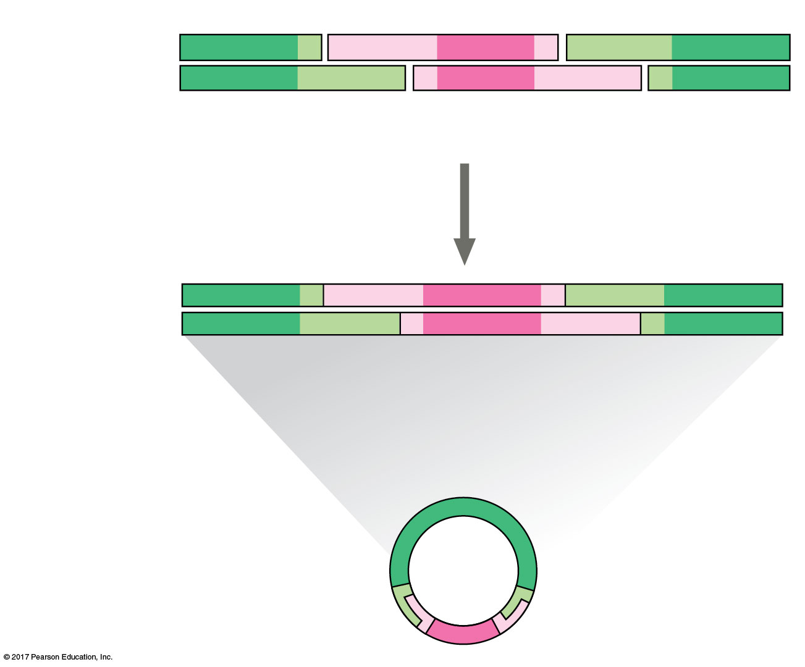
5′
3′5′
3′5′
3′
G
AAT T C
G
AA T T C
C
TTA A
G
C
TTAA
G
3′
5′3′
5′3′
5′
One possible combination
3
DNA ligase
seals the strands.
5′
3′
3′
Recombinant DNA molecule
5′
Recombinant
plasmid
© 2018 Pearson Education Ltd.

Slide 15
To check the recombinant plasmid, researchers might cut the products again using the same restriction enzyme
To separate and visualize the fragments produced, gel electrophoresis is carried out
This technique uses a gel made of a polymer to separate a mixture of nucleic acids or proteins based on size, charge, or other physical properties

Slide 16
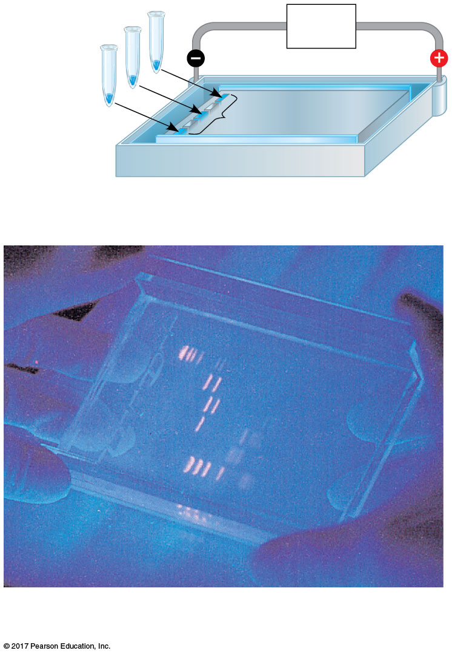
Mixture of
DNA mol-
ecules of
different
sizes
Power
source
Cathode
Anode
Wells
Gel
(a) Negatively charged DNA molecules will move toward the positive electrode.
Restriction fragments
(size standards)
(b) Shorter molecules are slowed down less than longer ones, so they move faster through the gel.

Slide 17
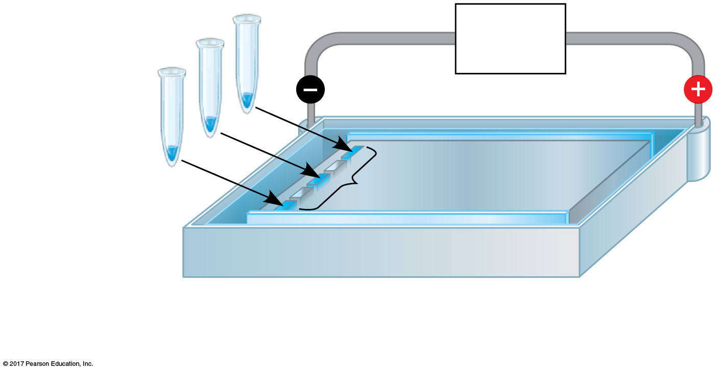
Mixture of
DNA mol-
ecules of
different
sizes
Power
source
Cathode
Anode
Wells
Gel
(a) Negatively charged DNA molecules will move toward the positive electrode.

Slide 18
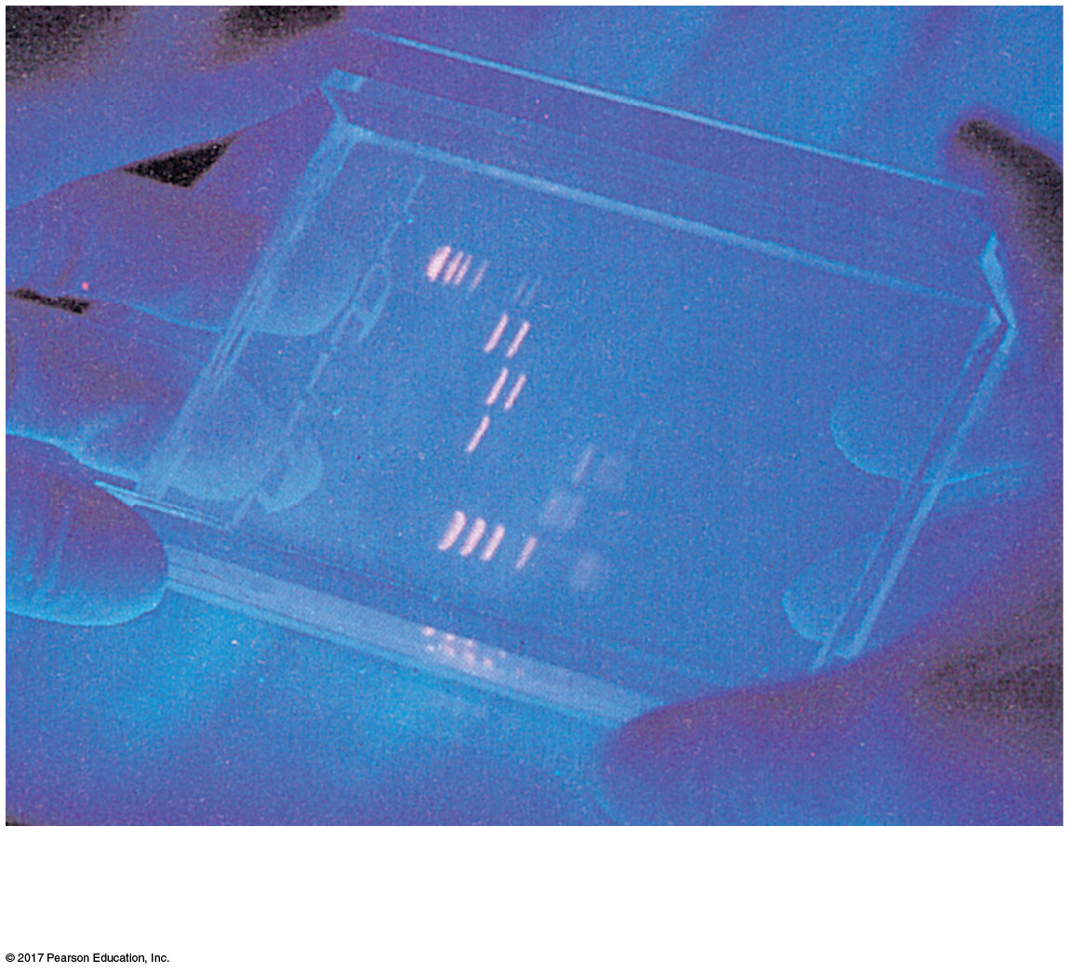
Restriction fragments
(size standards)
(b) Shorter molecules are slowed down less than longer ones, so they move faster through the gel.

Slide 19
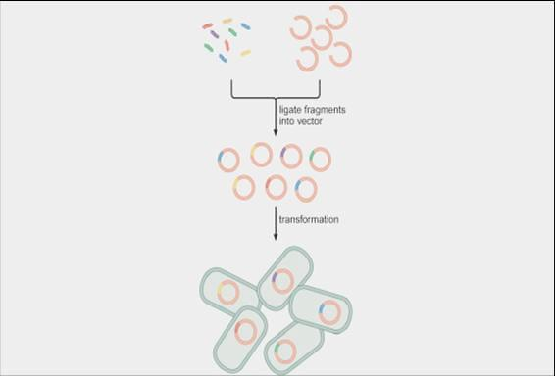
Genomic Library
Genomic library derived from total genomic DNA cleaved with a restriction enzyme.
It is useful when generating DNA for sequencing a genome.

Slide 20
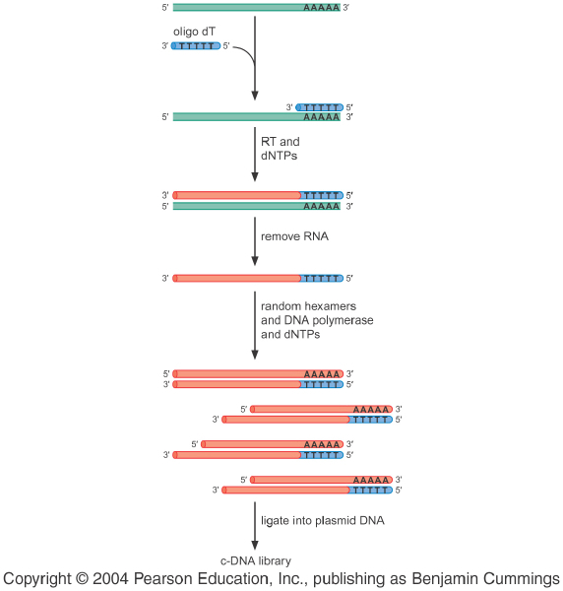
cDNA library
A cDNA (copy DNAs) library convert mRNA into DNA sequence using reverse transcriptase.
It is useful when the objective is to clone a DNA fragment encoding a particular gene.

Slide 21
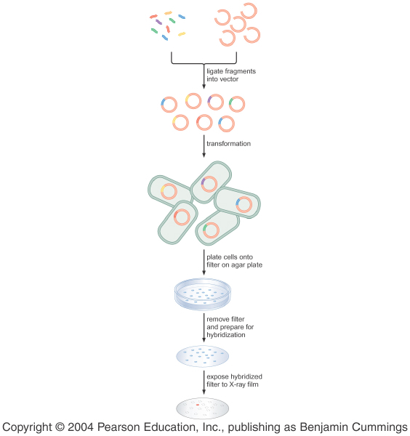
Hybridization Can Be Used to Identify a specific Clone in a DNA Library
colony hybridization
The process by which a labeled DNA probe is used to screen a library.
Note: If the library is made using a phage vector, they can be screened in much the same way as plasmid library. The difference is the plaques rather than colonies are screened.

Slide 22
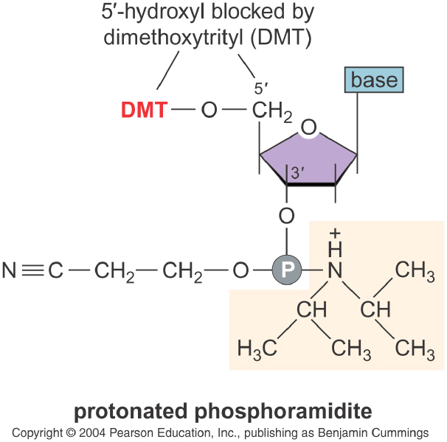
Chemically Synthesized Oligonucleotides
The 5’-hydroxyl group is blocked by the addition of a dimethoxyltrityl protecting group.
The growth of the DNA chain is by addition to the 5’ end of the molecule.

Slide 23
site-directed mutagenesis
Short DNA molecules up to 30 bases can be chemically synthesized efficiently and accurately.
A custom-designed oligonucleotide can harbor a mismatch to a segment of cloned DNA.

Slide 24
Nested Sets of DNA Fragments Reveal Nucleotide Sequencing
The ultimate in probing a genome with high selectivity, which permits us to find any specific sequence with great rapidity and accuracy through the use of a computer and appropriate algorithms.

Slide 25
The underlying principle of DNA sequencing
Separation of nested sets (the A,T,C,G set ) of DNA molecules by size
The different lengths of these fragments can be determined by electrophoresis through a polyacrylamide gel.
Alternatively, the four nested sets can be differentially labeled with distinct fluorophores, allowing them to be subjected to electrophoresis as a single mixture and distinguished later using fluorometry.

Slide 26
Two methods to create nested sets of DNA molecules
DNA molecules are radioactively labeled at their 5’ termini and are then subjected to four different regimens of chemical treatment that cause them to break preferentially at Gs, Cs, Ts, As. (no longer widely used)
chain-termination (prevalent)

Slide 27
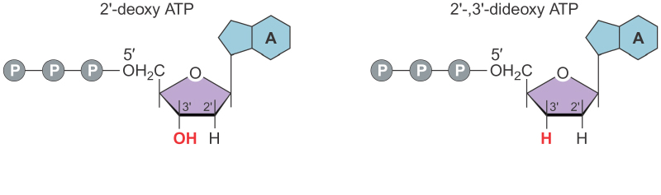
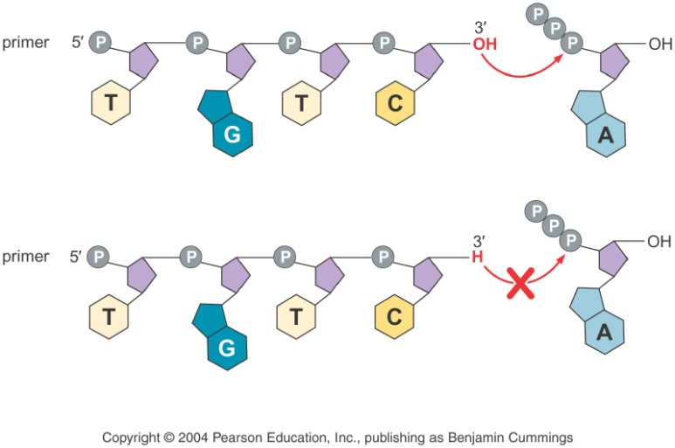
chain-terminating nucleotides
The chain termination method employ special, modified substrates called 2’-,3’-dideoxynucleotides (ddNTPs), which once incorporated at the 3’ end of a growing polynucleotide chain causes elongation to terminate.

Slide 28
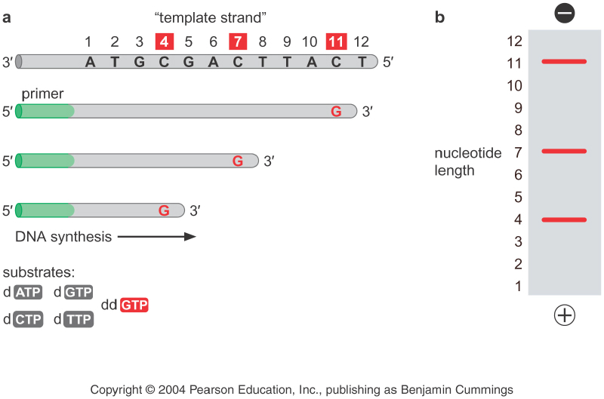
The chain termination method

Slide 29
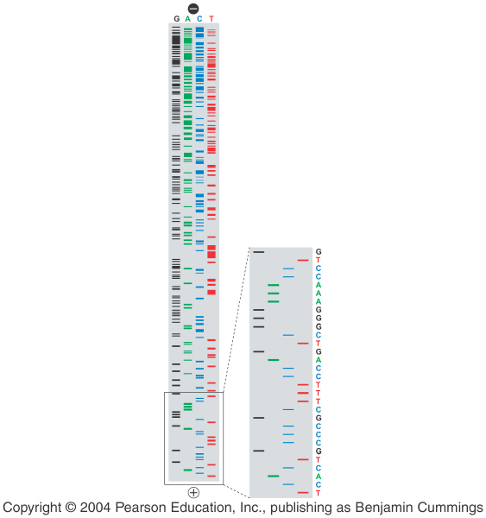
The chain termination method
We can read the full nucleotide sequence of the DNA by resolving the four nested sets of fragments on a polyacrylamide gel.

Slide 30
Technical advancement
The chain termination method had undergone a series of technical adaptions and improvements that allow the analysis of whole genomes.

Slide 31
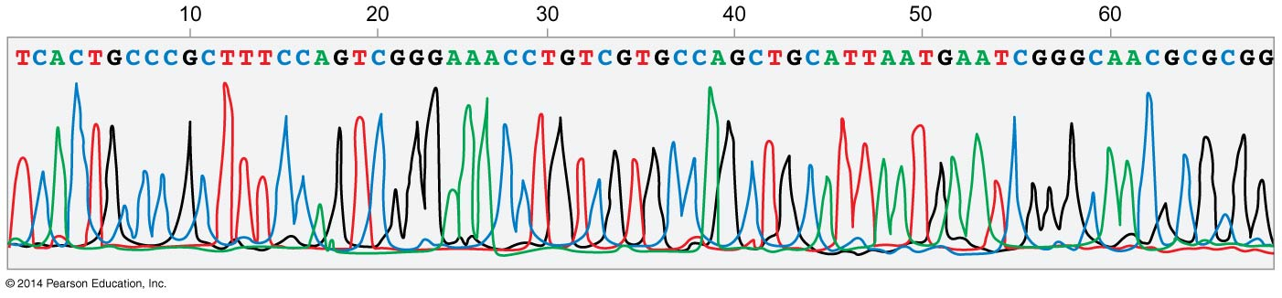
Technical advancement
Sequenator--- automated sequencing machine
fluorescent chain-terminating nucleotides--- label each of the nested DNAs with a single “color”

Slide 32
Shotgun Sequencing a Bacterial Genome
“shotgun” sequencing
1.The genome was randomly sheared into many fragments with an average size of 1kb.
2.The pieces were cloned into plasmid recombinant DNA vector.
3.DNA was prepared from individual recombinant DNA colonies and separately sequenced on Sequenators.

Slide 33
“shotgun” sequencing
In the method of “shotgun” sequencing, every nucleotide in the genome was sequenced ten times, which is known as 10× sequence coverage.
This method is more time consuming, but is faster and less expensive.

Slide 34
Sequencing by synthesis
In sequencing by synthesis, many DNA fragments are copied
A specific strand of each fragment is immobilized and the complementary strand synthesized one nucleotide at a time
Thousands or hundreds of thousands of fragments about 300 nucleotides long can be sequenced in parallel
This is an example of “high-throughput” technology

Slide 35
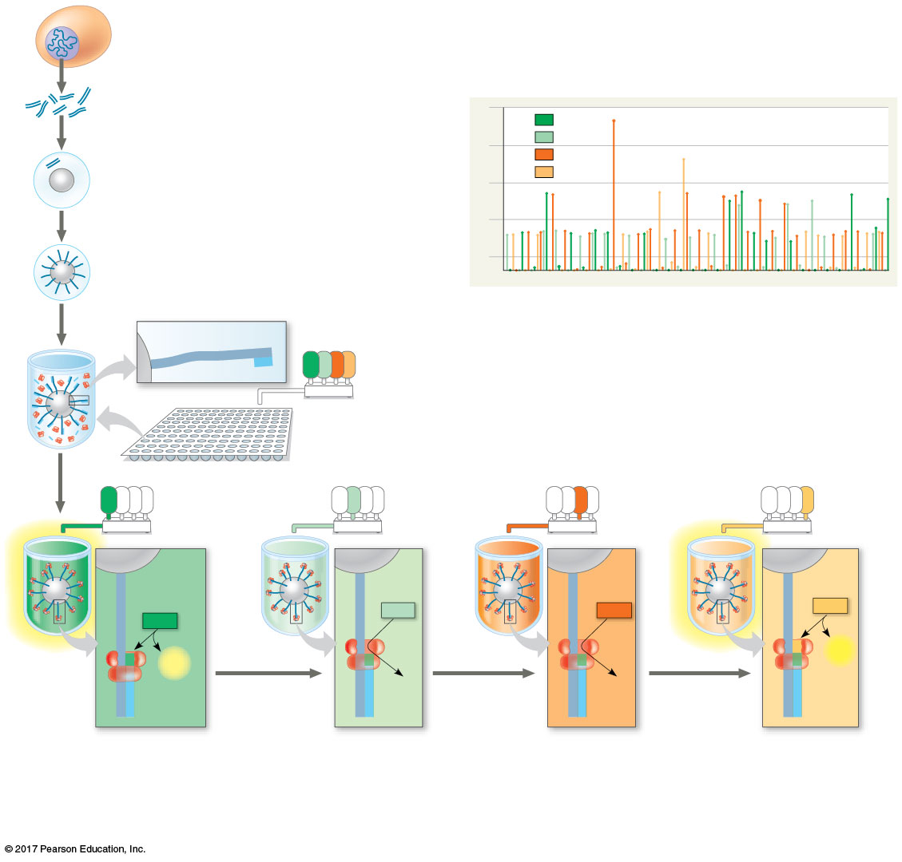
Technique
1
Genomic DNA is fragmented.
Results
2
Each fragment is isolated with a
bead.
No. of nucleotides in sequence
4
A
T
3
G
TTCTGCGAA
3
Using PCR, 10⁶ copies of each
fragment are made, each attached
to the bead by the 5′ end.
C
2
1
4
The bead is placed into a well with
DNA polymerases and primers.
Template strand
of DNA
3′
5′
3′
5′
A
T
G
C
Primer
5
Solutions of each of the four nucleotides are added
to all wells sequentially and then washed off.
The entire process is then repeated.
A
T
G
C
A
T
G
C
A
T
G
C
A
T
G
C
C
Template
strand
of DNA
C
C
C
C
C
C
C
dCTP
A
dATP
A
dTTP
A
dGTP
A
A
A
A
A
T
T
T
T
G
G
G
G
C
PP_{i}
DNA
polymerase
T
A
PP_{i}
T
A
T
A
T
A
G
C
G
C
G
C
G
C
G
C
G
C
G
C
G
C
A
G
Primer
A
G
A
G
A
G
T
A
T
A
T
A
T
A
6
If a nucleotide is joined to a
growing strand, PP_{i} is
released, causing a flash
of light that is recorded.
7
If a nucleotide is not
complementary to the
next template base,
no PP_{i} is released, and
no flash of light is recorded.
8
The process is repeated until every
fragment has a complete complementary
strand. The pattern of flashes reveals the
sequence.
© 2018 Pearson Education Ltd.

Slide 36
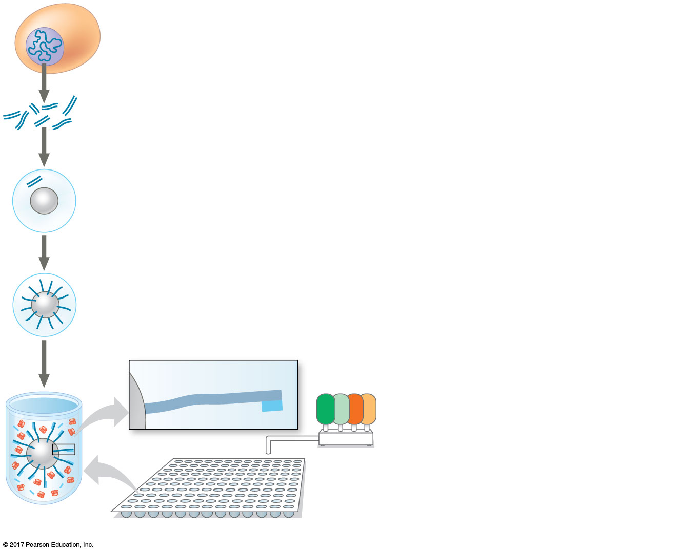
Technique
1
Genomic DNA is fragmented.
2
Each fragment is isolated with a
bead.
3
Using PCR, 10⁶ copies of each
fragment are made, each attached
to the bead by the 5′ end.
4
The bead is placed into a well with
DNA polymerases and primers.
Template strand
of DNA
3′
5′
3′
5′
A T
G C
Primer
5
Solutions of each of the four nucleotides
are added to all wells sequentially and
then washed off. The entire process is
then repeated.
© 2018 Pearson Education Ltd.
Notes:
Figure 19.3a Research method: sequencing by synthesis: next-generation sequencing (part 1)

Slide 37
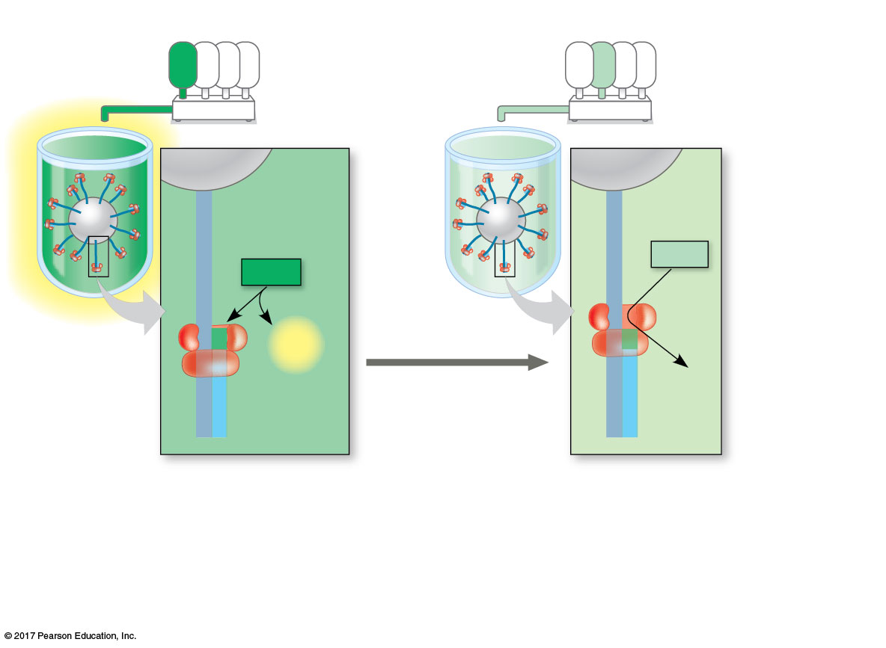
Technique
A T
G
C
A T
G
C
Template
strand
of DNA
C
C
C
C
A
A
dTTP
A
dATP
A
T
T
G
G
T
A
PP_{i}
T
A
DNA
polymerase
G
C
G
C
G
C
G
C
A
G
Primer
A
G
T
A
T
A
6
If a nucleotide is joined to
a growing strand, PP_{i} is
released, causing a flash
of light that is recorded.
7
If a nucleotide is not
complementary to the
next template base,
no PP_{i} is released, and
no flash of light is recorded.
© 2018 Pearson Education Ltd.
Notes:
Figure 19.3b Research method: sequencing by synthesis: next-generation sequencing (part 2)

Slide 38
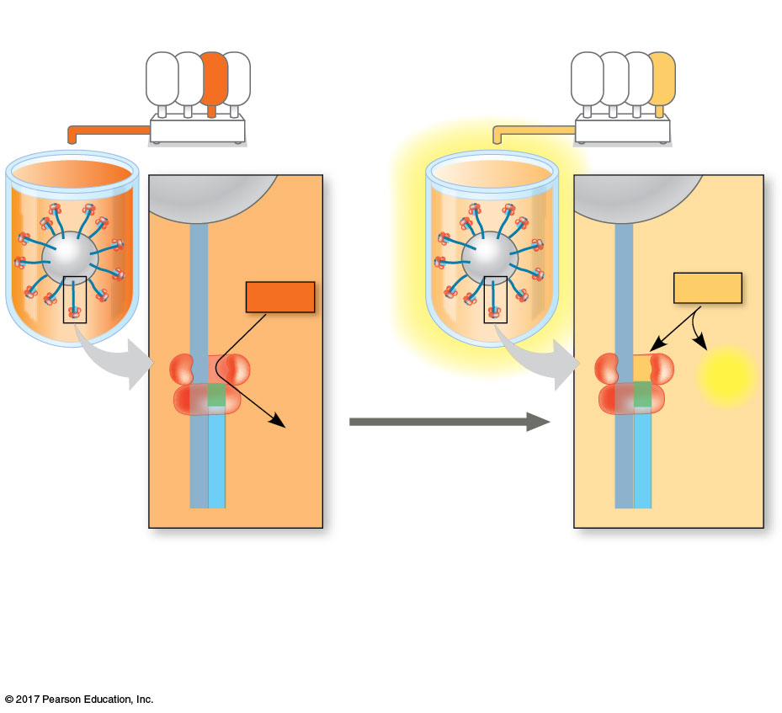
Technique
A T
G
C
A T
G
C
C
C
C
C
A
dGTP
A
dCTP
A
A
T
T
G
G
C
PP_{i}
T
A
T
A
G
C
G
C
G
C
G
C
A
G
A
G
T
A
T
A
8
The process is repeated until every
fragment has a complete complementary
strand. The pattern of flashes reveals the
sequence.
© 2018 Pearson Education Ltd.
Notes:
Figure 19.3c Research method: sequencing by synthesis: next-generation sequencing (part 3)

Slide 39
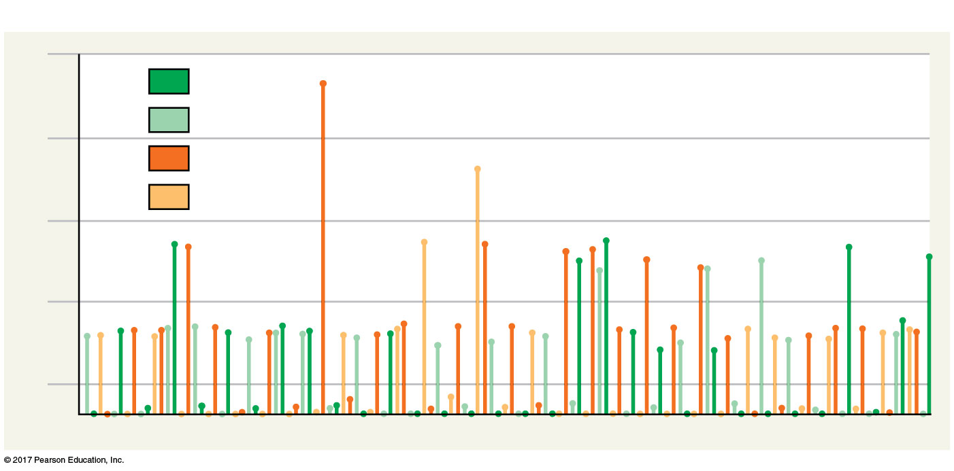
Results
No. of nucleotides in sequence
4
A
T
G
3
TTCTGCGAA
C
2
1
© 2018 Pearson Education Ltd.
Notes:
Figure 19.3d Research method: sequencing by synthesis: next-generation sequencing (part 4)

Slide 40
In “third-generation sequencing,” the techniques used are even faster and less expensive
In some methods, a single long DNA molecule is sequenced as it moves through a very small pore (nanopore)
In one such approach, each base is identified by the way it interrupts an electric current as it passes through the pore.

Slide 41
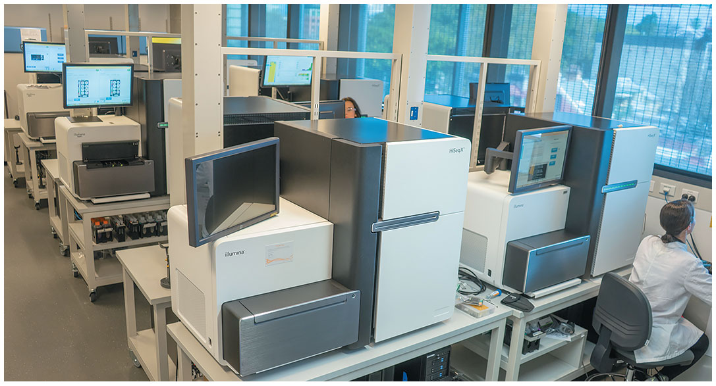
Next-generation DNA sequencing machines
© 2018 Pearson Education Ltd.

Slide 42
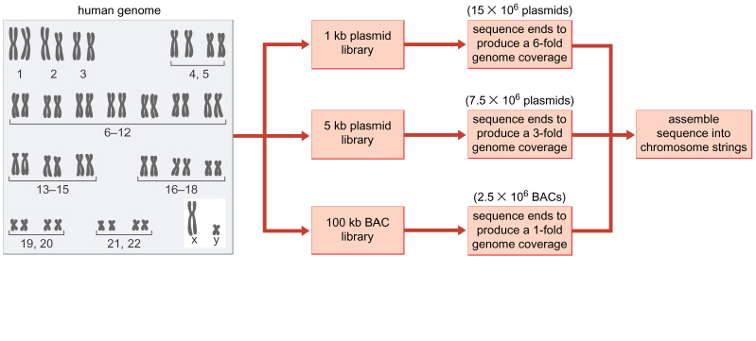
Strategy for construction and sequencing of whole genome libraries

Slide 43
The shotgun strategy permits a partial assembly of large genome sequence
Human Genome Project (HGP):
ⅰ.DNA was prepared from each of the 23 chromosomes that constitute the human genome, and then reduced into pools or libriaries of small fragments using small-gauge pressurized needles. (typically, two or three libraries are constructed for fragments of differing sizes)
ⅱ.These fragments were randomly cloned into bacterial plasmids
ⅲ.Recombinant DNA was isolated from bacterial plasmids and then quickly sequenced using Sequenator (with an average of 600 bp of DNA sequence per fragment, an average of two million random DNA fragments are processed, that is one billion bp of sequence data)
ⅳ.Sophisticated computer programs assemble the shotgun sequences into large contiguous sequences called contigs

Slide 44
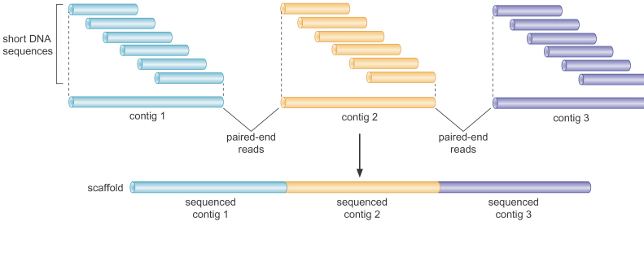
The paired-end strategy permits the assembly of large genome scaffolds
ⅴ.Relatively short contigs are assembled into larger scaffolds using paired-end sequencing

Slide 45
Genome-wide Analyses
Finding protein coding genes in bacteria and simple eukaryotes is relatively straightforward, essentially amounting to the identification of ORFs.
For animal genomes with complex exon-intron structures, the challenge is far greater.

Slide 46
Genome-wide Analyses
A variety of bioinformatics tools are required to identify genes and determine the genetic composition of complex genomes.
A notable limitation of current gene finder programs is the failure to identify promoters (such as TATA, INR, and DPE which are noncoding exons)
Computer programs should exploit more properties of a gene: core promoter elements, ORFs, splice sites etc. to identify protein coding genes in a consistent and effienct manner

Slide 47
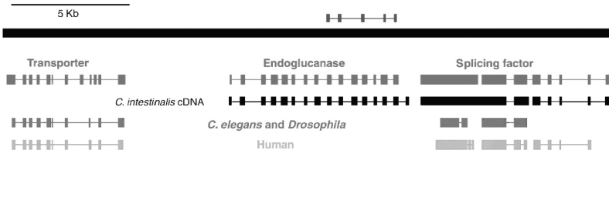
Genome-wide Analyses
The use of cDNA sequence data is an important way for validating predicted protein coding genes and identifying those missed by current gene finder programs.
EST (expressed sequence tag) is simply a short sequence read from a larger cDNA.
gene finder methods
Analysis of protein–coding regions in Ciona

Slide 48
Comparative Genome Analysis
The comparisons of different animal genomes not only permit a direct assessment of changes in gene structure and sequence that arisen during evolution but refine the identification of protein-coding genes within a given genome.

Slide 49
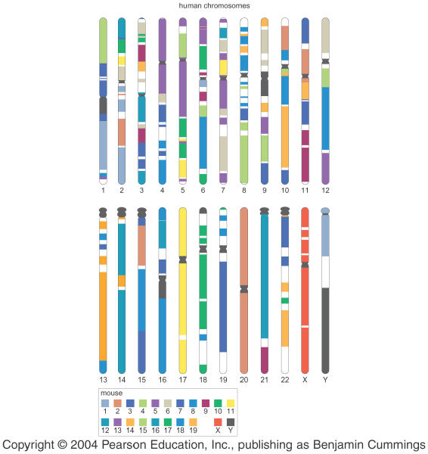
Comparative Genome Analysis
There is a high degree of synteny, conservation in genetic linkage, between distantly related animals.

Slide 50
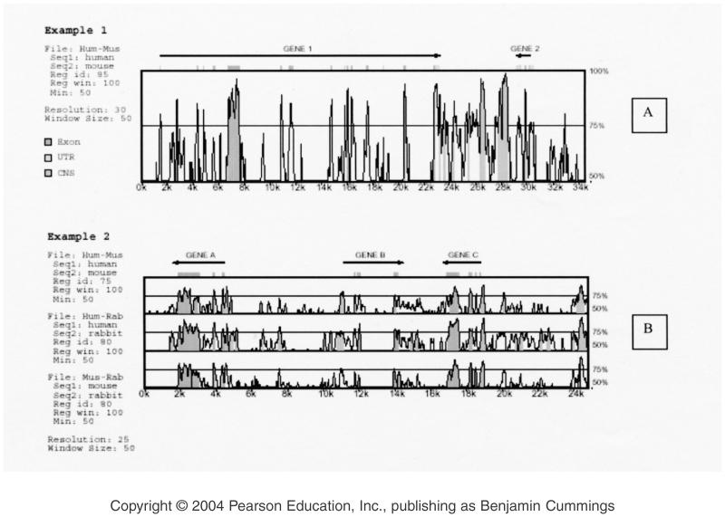
Comparative Genome Analysis
Protein-coding sequences and regulatory sequences are both tend to be conserved. But the identification of regulatory sequences poses a greater challenge.

Slide 51
Comparative Genome Analysis
BLAST (basic local alignment search tool) is a genome tool used to identify
BLAST search shares a common feature of finding regions of similarity between different protein coding genes.
A BLAST search can be done in several ways
One involves searching the genome or many genomes for all of the predicted protein sequences that are related to query sequence

Slide 52
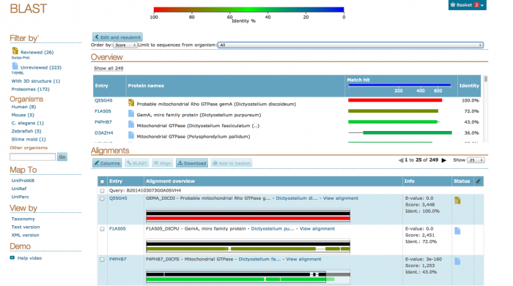
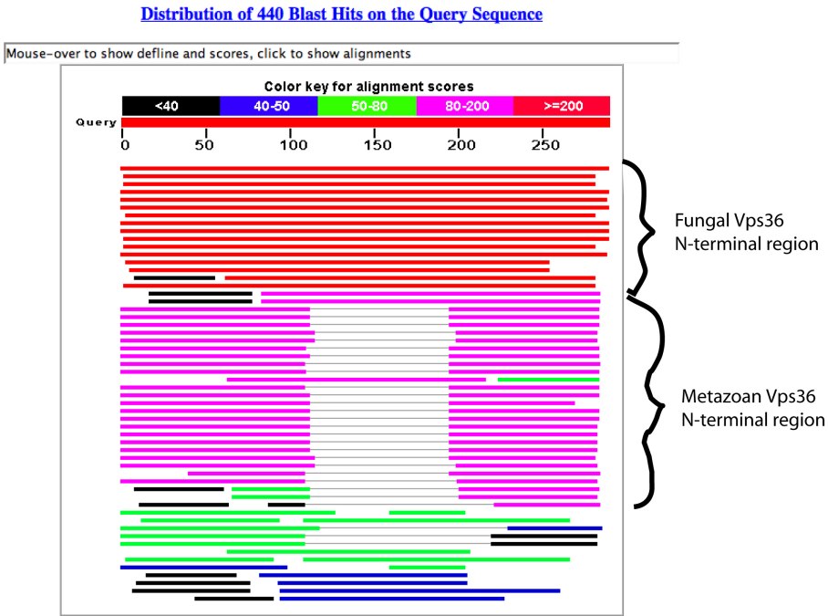
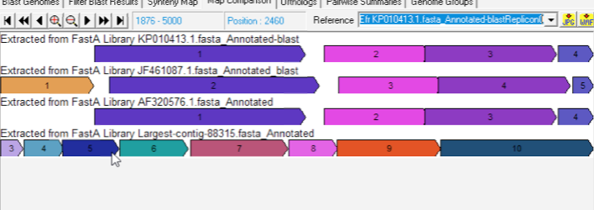
Comparative Genome Analysis
Example of a BLAST search

Slide 53
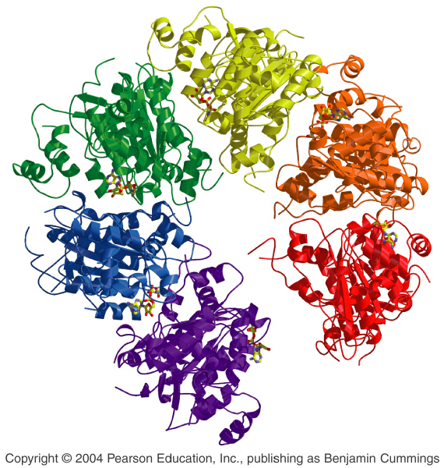
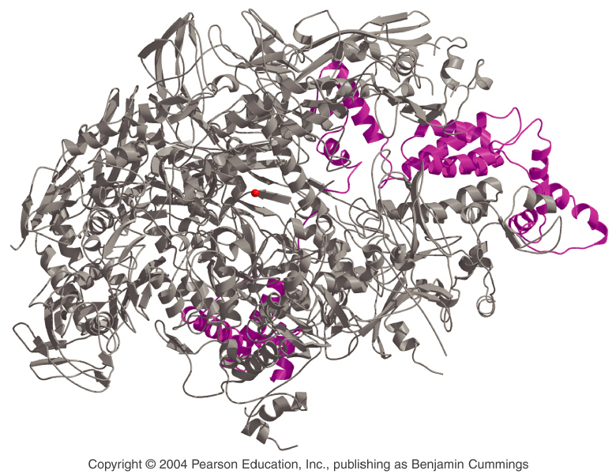
Proteins

Slide 54
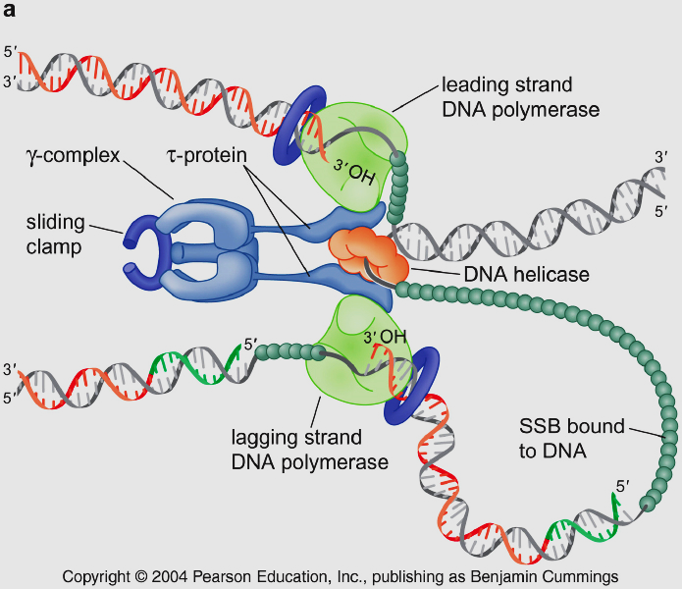
Specific proteins can be purified from cell extracts
The purification of individual proteins is critical to understanding their function.
The purification of a protein is designed to exploit its unique characteristics, including size, charge, shape, and function.

Slide 55
Purification of a protein requires a specific assay
Incorporation assay (get DNA, RNA or proteins labeled) are useful for monitoring the purification and function of many different enzymes catalyzing the synthesis of polymers like DNA, RNA, or proteins.

Slide 56
Preparation of cell extracts containing active proteins
Cell extracts can be lysed by detergent, shearing forces, treatment with low ionic salt or rapid changes in pressure.
The goal is to weaken and break the membrane surrounding the cell to allow proteins to escape.

Slide 57
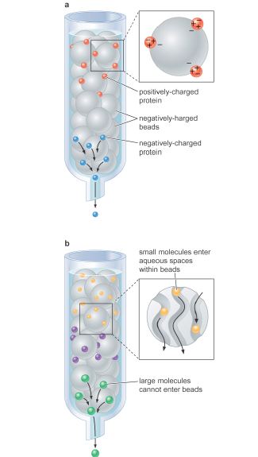
Proteins can be separated from one another using column chromatography
The two commonly used methods – ion exchange and gel filtration chromatography separate proteins on the basis of their charge and size respectively.

Slide 58
Affinity chromatography can facilitate more rapid protein purification
Other reagents can be attached to columns to allow the rapid purification of proteins, which is called affinity chromatography.

Slide 59
Immunoaffinity chromatography
In this approach, an antibody that is specific for target protein is attached to beads. Ideally, this antibody will interact only with the intended target protein. The bound protein can then be eluted from the column using salt or mild detergent.

Slide 60
Immunoaffinity chromatography
Proteins can be modified to facilitate their purification, adding short additional amino acid sequences to the N-terminus or C-terminus of a target protein.
This modification can be generated using molecular cloning methods or specific epitopes, which can be attached to any protein.

Slide 61
Immunoaffinity chromatography
Immunoprecipitation
Precipitation is achieved by attaching the antibody to the same type of bead used in a column chromatography. Because these beads are relatively large, they rapidly sink to the bottom of a test tube along with the antibody and any proteins bound to the antibody.
Immunoprecipitation is used to rapidly purify proteins or protein complexes from crude extracts.

Slide 62
Separation of proteins on polyacrylamide gels
Sodium dodecyl sulphate (SDS)
Electrophoresis in the presence of SDS can be used to resolve mixtures of proteins according to the length of individual polypeptide chains.
After electrophoresis, the proteins can be visualized with a stain, such as Coomassie brilliant blue

Slide 63
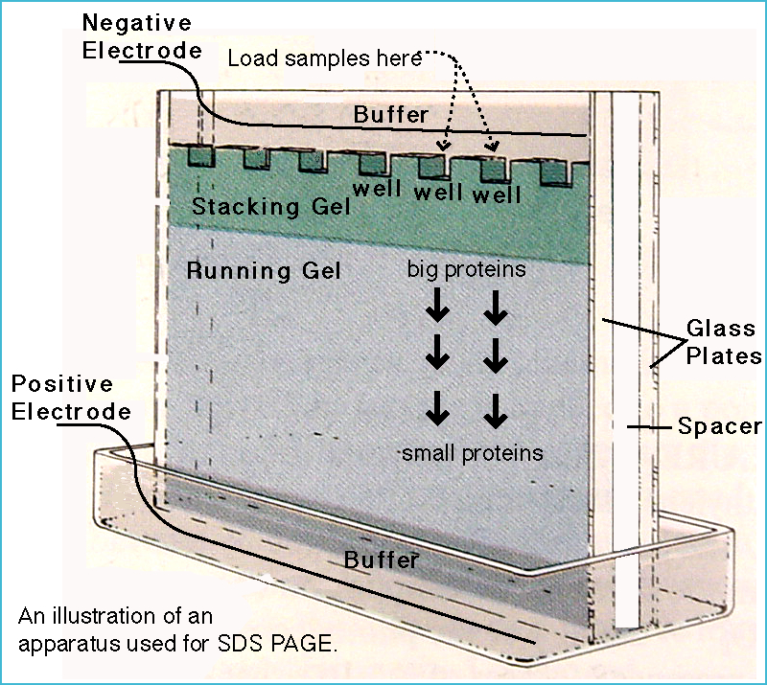

Slide 64
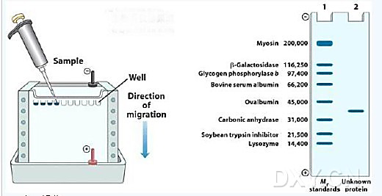
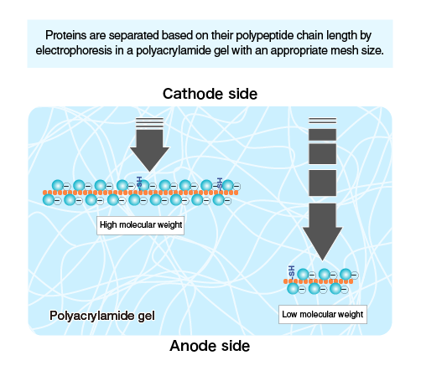
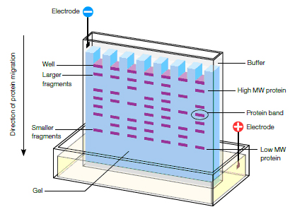

Slide 65
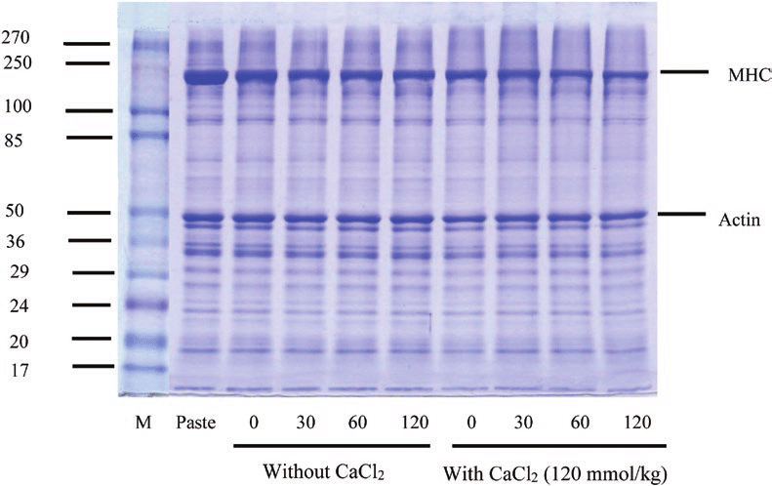

Slide 66
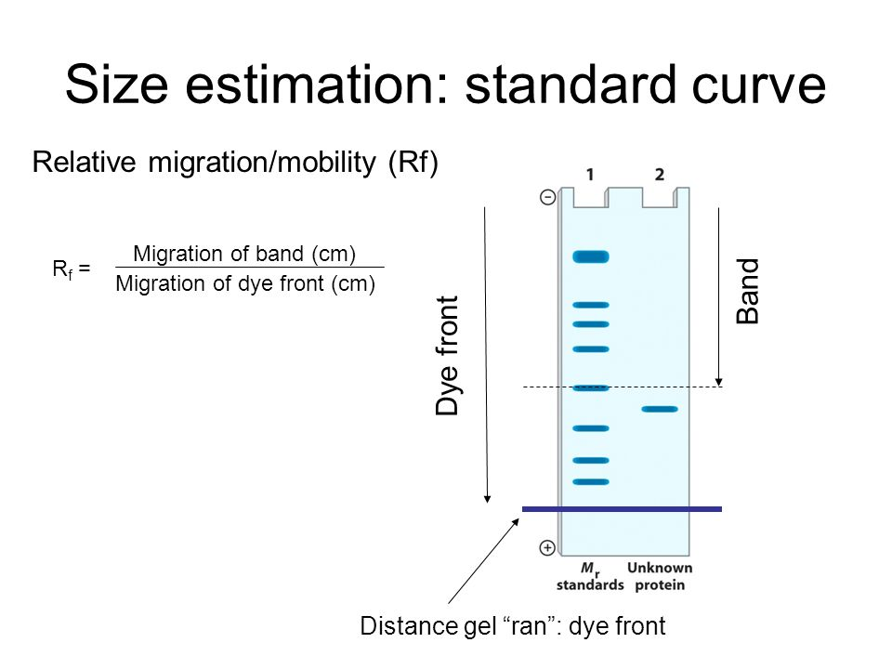

Slide 67
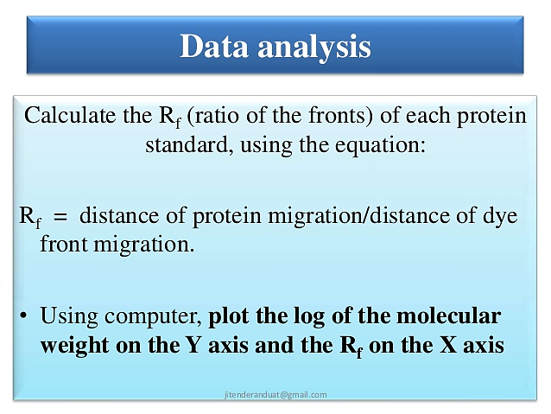

Slide 68
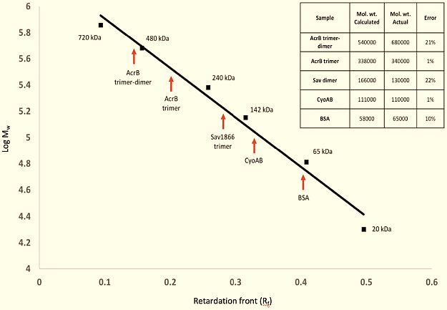

Slide 69
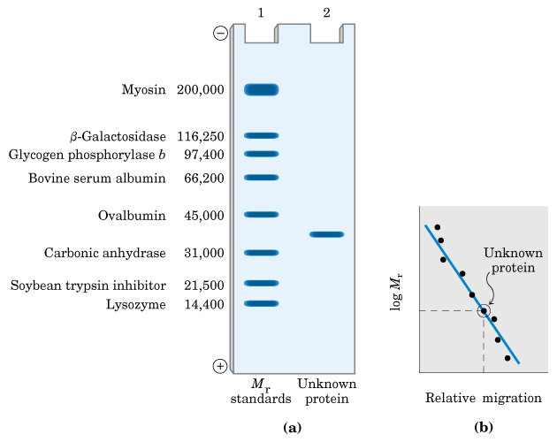
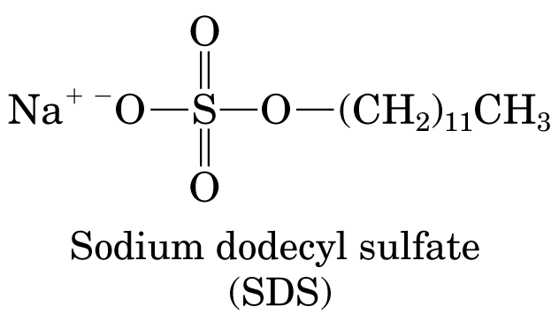
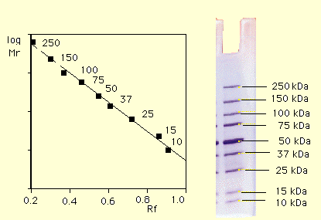
SDS-Polyacrylamide Gel Electrophoresis

Slide 70
Antibodies visualize electrophoretically-separated proteins
Immunoblotting (Westerns Blott)
Electrophoretically separated proteins are transferred and bound to a filter
The filter is then incubated in a solution of an antibody
The antibody finds the corresponding protein on the filter to which it avidly binds
A chromogenic enzyme is used to visualize the filter-bound antibody.

Slide 71
Protein molecules can be directly sequenced
Because of the vast resource of complete or nearly complete genome sequences, the determination of even a small stretch of protein sequence is often sufficient to identify the gene which encoded that protein by finding a matching ORF.

Slide 72
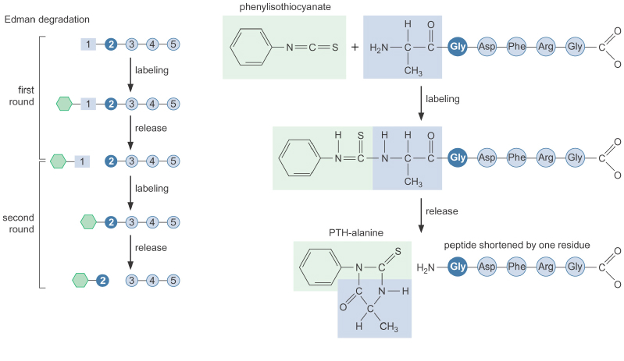
Edman degradation

Slide 73
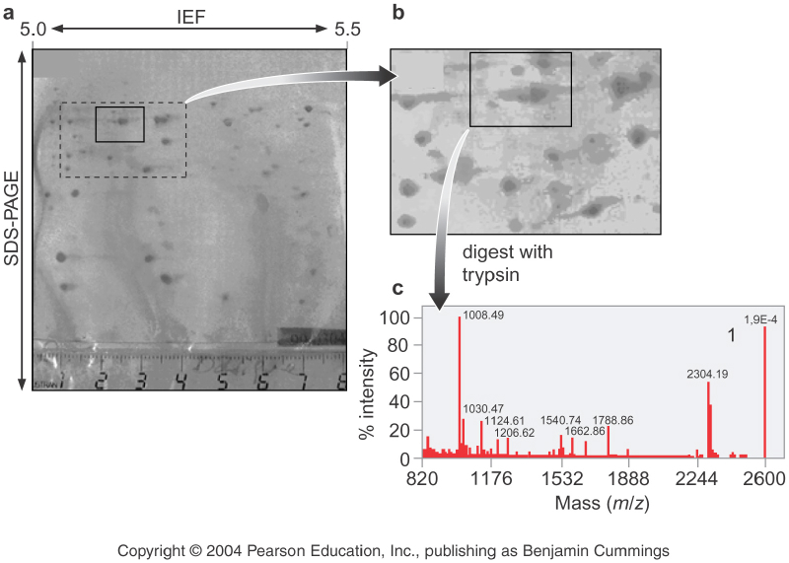
Tandem mass spectrometry (MS/MS)

Slide 74
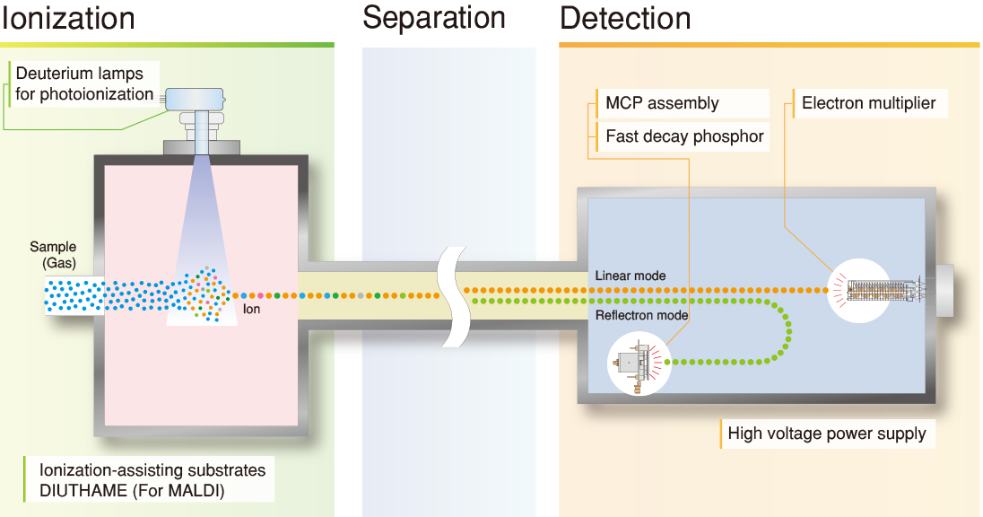
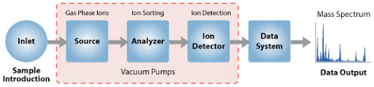

Slide 75
Tandem mass spectrometry (MS/MS)
MS/MS has revolutionized protein sequencing and identification.
Only very small amounts of material are needed, and complex mixtures of proteins can be simultaneously analyzed.

Slide 76
Proteomics
Proteomics is concerned with the identification of the full set of proteins produced by a cell or tissue under a particular set of conditions, their relative abundance, and their interacting partner proteins.

Slide 77
Three principal methods
Two-dimensional gel electrophoresis for protein separation
Mass spectrometry for the precise determination of molecular weigh and identity if a protein
Bioinformatics for assigning proteins and peptides to the predicted products of protein-coding sequences in the genome

Slide 78
Steps of proteomic analysis
2- Dimensional Gel Electrophoresis (2DGE)
1. The proteins are fractionated according to their isoelectric point by isoelectric focusing
2. The proteins are separated according to size by SDS gel electrophoresis
3. Each protein is separately subjected to MS/MS analysis which allows the precise sequence to be identified
4. The peptide sequences are assigned to a particular protein-coding sequence in the genome using the tools of bioinformatics

Slide 79


Slide 80


Slide 81
END

